Slide 1
Terminology
Architecture
An overall blueprint/model describing the structures and properties of a "system”
Software architecture
Captures the gross structure of a system
How it is composed of interacting parts
How the interactions take place
Key properties of the parts
Provides a way of analyzing systems at a high level of abstraction!
Illuminates top-level design decisions

Slide 2
Software architecture patterns
Are software patterns that offer well-established solutions to architectural problems in software engineering.
Gives description of the elements and relation type together with a set of constraints on how they may be used.
express a fundamental structural organization schema for a software system, which consists of subsystems, their responsibilities and interrelations.
In comparison to design patterns, architectural patterns are larger in scale.

Slide 3




typical architectural patterns (styles)
How can I integrate multiple applications so that they work together and can exchange information?
integration styles for (enterprise) messaging
File Transfer
Shared Database
Remote Procedure
Messaging

Slide 4
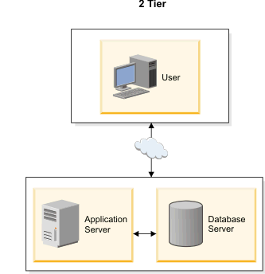
tiered architecture (layering)
2 - tier architecture (traditional client-server)
A two-way interaction in a client/server environment, in which the user interface is stored in the client and the data are stored in the server.
The application logic can be in either the client or the server.

Slide 5
3 tier architecture

Slide 6
model-view-controller (1)
The MVC paradigm is a way of breaking an application, or even just a piece of an application's interface, into three parts: the model, the view, and the controller.
MVC was originally developed to map the traditional input, processing, output roles into the GUI realm:
Input → Processing → Output
Controller → Model → View

Slide 7
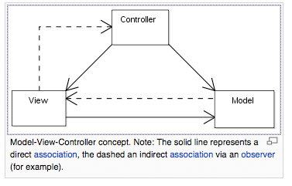
Model View Controller (MVC)
The intent of MVC is to keep neatly separate objects into one of tree categories
Model
The data, the business logic, rules, strategies, and so on
View
Displays the model and usually has components that allows user to edit change the model
Controller
Allows data to flow between the view and the model
The controller mediates between the view and model

Slide 8
Model
Responsibilities
Provide access to the state of the model
getters, toString, other methods that provide info
Provide access to the system's functionality
changeRoom(int), shootArrow(int)
Notify the view(s) that its state has changed
// If extending Java’s Obervable class, do NOT forget
// to tell yourself your state has changed
super.setChanged();
// Otherwise, the next notifyObservers message will not
// send update messages to the registered Observers
this.notifyObservers();

Slide 9
View
Responsibilities
Display the state of the model to users, accept input
The model (a.k.a. the Observable) must register the views (a.k.a. Observers) so the model can notify the observers that its state has changed
Java’s Observer/Observable support provides
public void addObserver(Observer o)
// Adds an observer to the set of observers for this
// object, provided that it is not the same as some
// observer already in the set.

Slide 10
Controller
Responsibilities
Respond to user input (events)
Button click, key press, mouse click, slider bar change
Send messages to the model, which may in turn notify it observers
Send appropriate messages to the view
In Java, controllers are implemented as listeners
An ActionListener object and its actionPerformed method is a Controller

Slide 11
Sun says
Model-View-Controller ("MVC") is the recommended architectural design pattern for interactive applications
MVC organizes an interactive application into three separate modules:
one for the application model with its data representation and business logic,
the second for views that provide data presentation and user input, and
the third for a controller to dispatch requests and control flow.

Slide 12
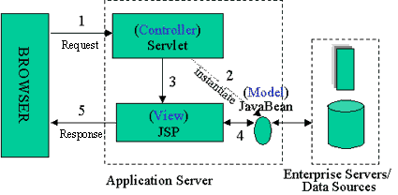
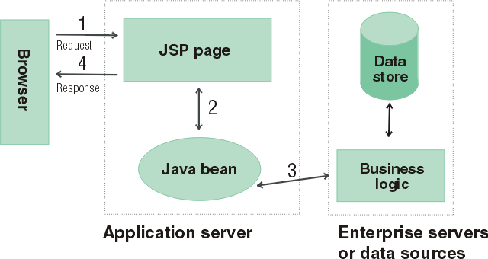
Java Server Pages
Model: Enterprise Beans with data in the DBMS
JavaBean: a class that encapsulates objects and can be displayed graphically
Controller: Servlets create beans, decide which JSP to return
Servlet object do the bulk of the processing
View: The JSPs generated in the presentation layer (the browser)

Slide 13
MVC Benefits
The pattern isolates business logic from input and presentation, permitting independent development, testing and maintenance of each.
Clarity of design
easier to implement and maintain
Modularity
changes to one doesn't affect other modules
can develop in parallel once you have the interfaces
Multiple views
spreadsheets, powerpoint, file browsers, games, Eclipse, UML reverse engineering, ….

Slide 14
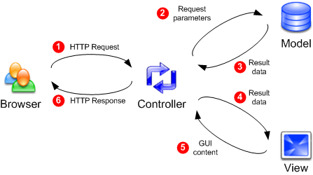
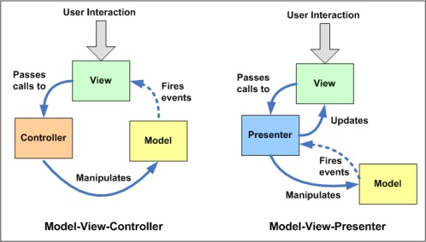
Two Views of MVC

